Slide 1
Machine Learning Basics on Linear Factor Models 1. Data Prep

Slide 2
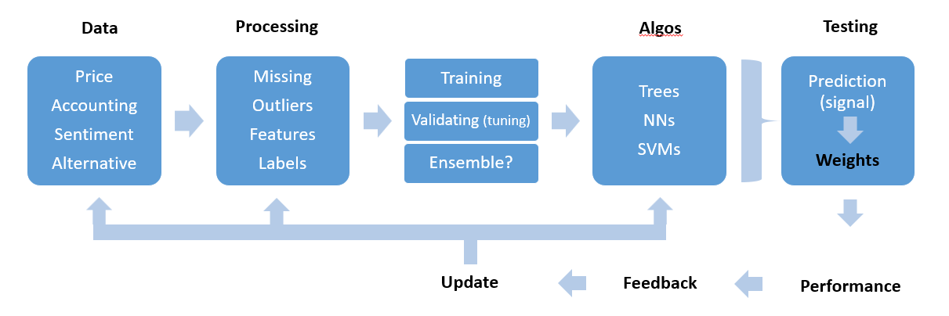
ML-Based Factor Construction Workflow

Slide 3
Financial Data Characteristics
Low signal-to-noise ratio
Financial covariance matrices are notoriously noisy as a result of arbitrage forces and nonstationary systems.
Complex (e.g., non-linear and interactive) relationships (or patterns) among variables
Traditional techniques are extremely sensitive to that multicollinearity problem.
Many new, interesting data sets available are unstructured, high-dimensional, and sparse
Unstructured data can also be non-numerical and non-categorical (e.g., news articles, voice recordings, etc.).
High-dimensional data sets, where # of variables > # of observations (e.g., credit card transactions), make it difficult to apply linear algebra solutions.
Sparse data sets, where samples may contain a large proportion of zeros, make standard notions such as correlation unfeasible.

Slide 4
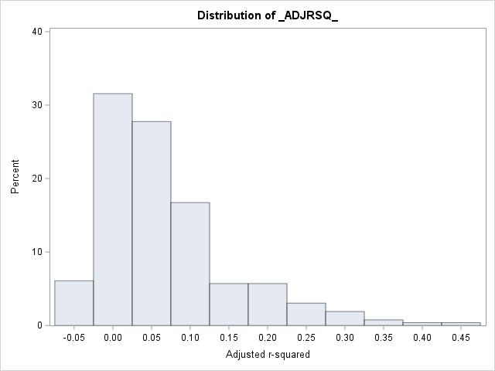
Low signal-to-noise ratio in return prediction
Use the following factors to predict monthly stock returns for Nasdaq-100 stocks for 2000:01-2021:12
Run Fama-MacBeth (1972) cross-sectional regressions (i.e., run the regression for each month, with proper treatment of outliers, etc.), adjusted R-squared has a mean of 0.067.

Slide 5
Data Analysis
Data Sources
Make sure the data comes from a reliable provider.
Well-established providers (e.g., Bloomberg, Thomson-Reuters, Datastream, CRSP, Morningstar).
Recent providers (e.g., Capital IQ, Ravenpack).
Alternative data niches (e.g., AlternativeData.org).

Slide 6
Data Analysis
Data Set
Monthly information on S&P 1500 stocks.
Time range starts in January 1980 and ends in December 2019.
For each point in time, 50 characteristics describe the firms in the sample
Attributes cover a wide range of topics (see Hou et al. (2018), Hu (2019)):
Momentum
Value-versus-Growth
Investment
Profitability
Intangibles
Trading Frictions
Technical Indicators

Slide 7
Data Analysis
Data Set (cont’d)
The sample is not perfectly rectangular (i.e., the number of firms and their attributes is not constant through time).
Snippet of loading, ordering, and showing sample values.
The first two columns indicate the stock identifier and the date. The next 50 columns are the features, and the last four columns are the labels (i.e., 1-month, 3-month, 6-month, and 12-month future/forward returns of the stocks).
In anticipation for future models, keep the name of predictors in memory and keep a shorter list of predictors.
Snippet of feature names and shorter list.

Slide 8
Data Analysis
Summary Statistics
Ranges, averages, and medians.
Snippet summary statistics for future returns.
Histograms or plots of time series to track local patterns or errors.
Snippet of histograms for a particular factor
Second order quantities to spot collinearities.
Snippet of box plot showing distribution of correlations between features and the one-month ahead return.

Slide 9
Data (Pre) Processing
Missing Data
Two ways to deal with missing data: removal and imputation.
Removal. It is agnostic but costly, especially if one whole instance is eliminated because of only one missing feature value.
Imputation. We can impute our data using the following: (i) the median or mean of the stock over the past available values; (ii) previous values particularly in time series; and (iii) the median or mean computed over the cross-section of assets.
Imputation should be avoided in certain feature types, e.g., returns (a superior choice is to set the missing return indicators to zero). A good indicator that can help the decision is the persistence of the feature through time. We want to impute from the past highly auto-correlated data, e.g., market capitalization.
Snippet of setting to zero missing future returns.

Slide 10
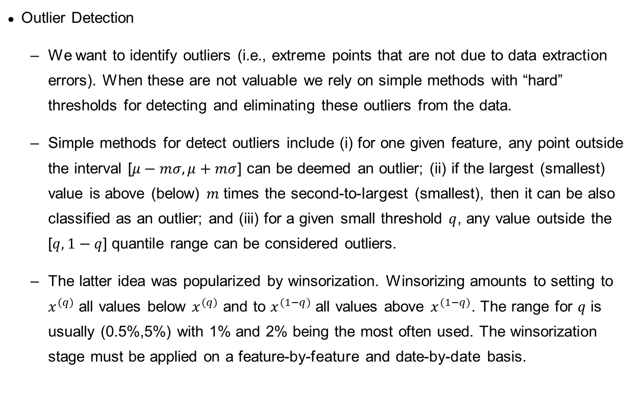
Data (Pre) Processing
Outlier Detection
We want to identify outliers (i.e., extreme points that are not due to data extraction errors). When these are not valuable we rely on simple methods with “hard” thresholds for detecting and eliminating these outliers from the data.
Simple methods for detect outliers include (i) for one given feature, any point outside the interval [$μ−mσ,μ+mσ$] can be deemed an outlier; (ii) if the largest (smallest) value is above (below) $m$ times the second-to-largest (smallest), then it can be also classified as an outlier; and (iii) for a given small threshold $q$, any value outside the [$q,1−q$] quantile range can be considered outliers.
The latter idea was popularized by winsorization. Winsorizing amounts to setting to $x^{(q)}$ all values below $x^{(q)}$ and to $x^{(1−q)}$ all values above $x^{(1−q)}$. The range for $q$ is usually (0.5%,5%) with 1% and 2% being the most often used. The winsorization stage must be applied on a feature-by-feature and date-by-date basis.

Slide 11
Data (Pre) Processing
Feature Engineering
Feature Engineering is a key step of the portfolio construction process.
We want to prevent the ML engine of the allocation to be trained on ill-designed variables.
Feature Selection.
Given a large set of predictors, our first step is filtering out unwanted or redundant exogenous variables.
Simple methods include: (i) computing the correlation matrix of all features and making sure that no absolute value is above a threshold (e.g., 0.70 is a common value); (ii) carrying out a linear regression and removing the non-significant variables (e.g., those with p-value above 0.05); and (iii) perform a clustering analysis over the set of features and retain only one feature within each cluster. These methods are reductive and overlook nonlinear relationships.
Another approach would be to fit a decision tree and retain only the features that have a high variable importance.

Slide 12
Data (Pre) Processing
Feature Engineering
Scaling the Predictors. We need to pre-process financial data coming from a large variety of scales (e.g., returns, stock volatility, market capitalization, accounting values, accounting ratios, and synthetic attributes like sentiment).
Common scaling practices include: (i) standardization, (ii) min-max rescaling over [0,1], (iii) min-max rescaling over [-1,1], and uniformization. Sometimes we apply a logarithmic transform of variables with both large values (e.g., market capitalization) and large outliers. The scaling can come after this transformation.
For neural networks for instance it is often advised to scale inputs so that they range in [0,1] before sending them through the training.
The data set used in these lectures have been uniformized, i.e., at each point in time, the cross-sectional distribution of each feature is uniform over the unit interval. In factor investing, the scaling of features is operated separately for each date and each feature. This ensures that the predictors will have a similar shape and do carry information on the cross-section of stocks.
Other versions of uniformization include ranking and subtraction of 0.5 to all features to keep values within certain range.
Scaling features across dates should be proscribed given that it would lead to small (large) values at the beginning (end) of the sample.
Snippet of scaling the predictors by uniformization.

Slide 13
Data (Pre) Processing
Labelling
When constructing portfolio policies, we can define labels for future performance proxies in several ways.
Simple Labels. In factor investing they may include (i) future relative returns; (ii) the probability of positive return; (iii) the probability of outperforming a benchmark; (iv) the binary version of yes (outperforming) vs. no (underperforming); and (v) risk-adjusted versions of Sharpe ratios, information ratios, MAR, or CALMAR ratios, etc.
Categorical Labels. Sometimes we want to forecast categories (or classes), like “buy”, “hold”, and “sell”. To perform this type of classification analysis, we create additional labels that are categorical. It is often advised that the decision thresholds are chosen such that the three categories are relatively balanced, so that they can end up having a comparable number of instances.
Snippet of creating binary labels for returns labels.
Other method, e.g., the Triple Barrier Method. This is an advanced labeling technique designed to consider the full dynamics of a trading strategy and not a simple performance proxy. See De Prado (2018). Similar to support and resistance + a band filter in technical analysis.

Slide 14

Practice exercise
Given the data provided (i) load the data, (ii) provide the summary statistics and distribution plots, (iii) impute any missing data using the cross-sectional median for the feature (not necessarily the best solution), (iv) evaluate if there are any outliers and winzorize them assuming that $q$ is 1%, then (v) drop any redundant factors (e.g., with a correlation higher than 0.7); (vi) normalize all the features to the $\left[0,1\right]$ range; and (vii) split the sample into a training set, a validation set, and a testing set.

